Slide 1
Results
Textract supports: JPG, PNG, TIFF, PDF
Can decipher text even with marker over it
Does not predict characters when covered completely
Cursive writing is understood properly
May be problematic when text is too small and too blurry
(as long as good photos are taken, there won’t be issues)

Slide 2
Pipeline
User uploads file which front end generates a unique name and sends to the storage lambda
Storage lambda renames the file and sends it to S3 storage bucket
Notify Success
Notify Complete
Front end
Storage Lambda
Upload file to S3
Storage Lambda
Front end
Front end displays data and allows user to modify
Raw data is returned to lambda which does some filtering and processing.
FrontEnd calls textract lambda to process uploaded file
textract provides data back to the front end.
lambda uses AWS textract to find read file in S3 storage bucket
User modify data
Front end
textract lambda
AWS Textract + S3 process
textract lambda
user modifies + saves data
Front end calls DBpopulator to save the new modified data.
DB Populator creates new rows in appropriate RDS tables
RDS returns success result to lambda
DB populator returns success message
Front end
DBpopulator lambda
RDS
DBpopulator lambda
Front end
lambda returns data to be displayed in front end.
RDS returns rows of specified table and user
populate page accesses rds to read data.
Front end calls populate page to update page with new data
Front end
populate page lambda
RDS
populate page lambda

Slide 3
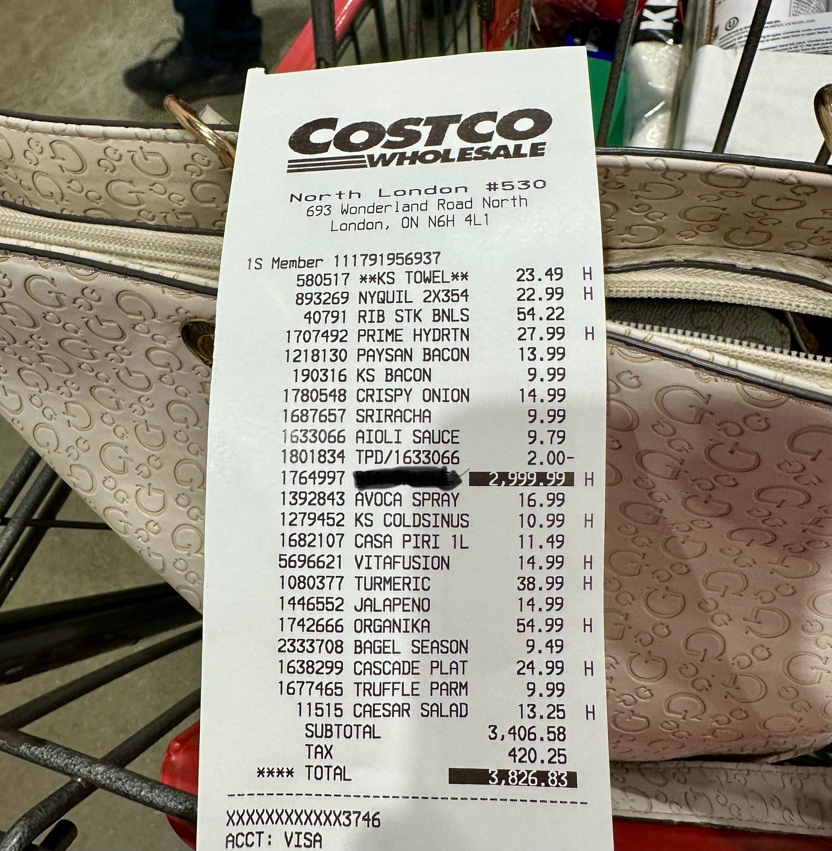
receiptcostco3.jpg
H
1392843 AVOCA SPRAY
16.99
1279452 KS COLDSINUS
10.99 H
1682107 CASA PIRI 1L
11.49
5696621 VITAFUSION
14.99 H
1080377 TURMERIC
38.99 H
1446552 JALAPENO
14.99
1742666 ORGANIKA
54.99 H
2333708 BAGEL SEASON
9.49
1638299 CASCADE PLAT
24.99 H
1677465 TRUFFLE PARM
9.99
11515 CAESAR SALAD
13.25 H
SUBTOTAL
3,406.58
TAX
420.25
**** TOTAL
3,826.83
XXXXXXXXXXXX3746
ACCT: VISA
COSTCO
WHOLESALE
North London #530
693 Wonderland Road North
London, ON N6H 4L1
1S Member 111791956937
580517 **KS TOWEL**
23.49 H
893269 NYQUIL 2X354
22.99 H
40791 RIB STK BNLS
54.22
1707492 PRIME HYDRTN
27.99 H
1218130 PAYSAN BACON
13.99
190316 KS BACON
9.99
1780548 CRISPY ONION
14.99
1687657 SRIRACHA
9.99
1633066 AIOLI SAUCE
9.79
1801834 TPD/1633066
2.00-
1764997
2,999.99

Slide 4
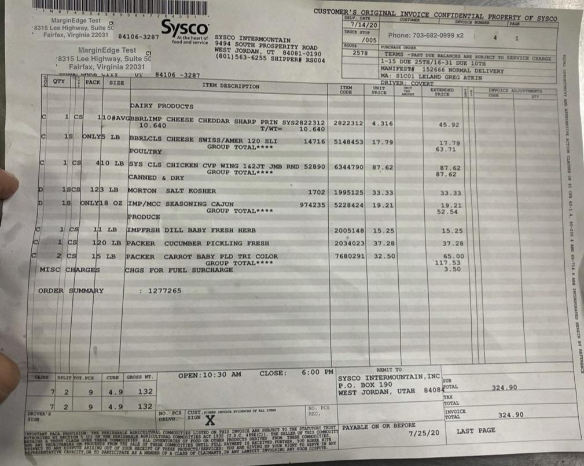
receiptsysco1.jpg
CUSTOMER'S ORIGINAL INVOICE CONFIDENTIAL PROPERTY OF SYSCO
DKLV DATE
CUSTOMER
INVOICE NUMBER
PAGE
MarginEdge Test
Sysco
7/14/20
8315 Lee Highway. Suite 50
TROCK STOP
Phone: 703-682-0999 x2
Fairfax, Virginia 22031
4
1
84106-3287
At the heart of
SYSCO INTERMOUNTAIN
/005
food and service
9494 SOUTH PROSPERITY ROAD
ROUTE
PURCHASE ORDER
MarginEdge Test
C
WEST JORDAN, UT 84081-0190
2578
8315 Lee Highway, Suite 50
(801) 563-6255 SHIPPER# RS004
TERMS -PAST DUE BALANCES ARE SUBJECT TO SERVICE CHARGE
1-15 DUE 25TH/16-31 DUE 10TH
Fairfax, Virginia 22031
MANIFEST# 152666 NORMAL DELIVERY
MARK WATE
UT
84106 -3287
MA: S1C01 LELAND GREG ATKIN
QTY
PACK
SIZE
DRIVER: COVERT
ITEM DESCRIPTION
ITEM
UNIT
-
EXTENDED
INVOICE ADJUSTMENTS
CODE
PRICE
AMOUNT
PRICE
CODE
QTY
ACC
DAIRY PRODUCTS
c
1 CS
10
O#AVGRBRLIMP CHEESE CHEDDAR SHARP PRIN SYS2822312
2822312
4.316
10.640
45.92
T/WT=
10.640
C
1S
ONLY'S LB
BBRLCLS CHEESE SWISS/AMER 120 SLI
14716
5148453
17.79
17.79
GROUP TOTAL****
63.71
ACTIVE
POULTRY
C
1
CS
410 LB
SYS CLS CHICKEN CVP WING 142JT JMB RND 52890
6344790
87.62
87.62
CLAIM
GROUP TOTAL
87.62
CANNED & DRY
OF
:
D
1SCS
123 LB
MORTON SALT KOSHER
1702
1995125
33.33
33.33
9
D
1S
ONLY1 8 oz
IMP/MCC SEASONING CAJUN
974235
5228424
19.21
19.21
$
GROUP TOTAL
52.54
PRODUCE
.
$
C
1
CS
11 LB
IMPFRSH DILL BABY FRESH HERB
2005148
15.25
15.25
ME
C
1
CS
120 LB
PACKER CUCUMBER PICKLING FRESH
2034023
37.28
37.28
2
CS
15 LB
PACKER CARROT BABY PLD TRI COLOR
7680291
32.50
65.00
GROUP TOTAL
117.53
MISC CHARGES
CHGS FOR FUEL SURCHARGE
3.50
.
AND
ORDER SUMMARY
: 1277265
SECURITY
CASES
SPLIT TOT PCS
CUBE
GROSS WT.
OPEN:10:30 AM
CLOSE:
6:00 PM
REMIT TO
SYSCO INTERMOUNTAIN, INC
SUB
7
2
g
132
P.O. BOX 190
4.9
TOTAL
WEST JORDAN, UTAH 8408
324.90
TAX
7
2
9
4.9
132
CUST INVOICE EVED or ALL STAMP
NO. PCS
TOTAL
DRIVER'S &
NO PCS
SIGN
DELVD
SIGN
REC.
INVOICE
X
TOTAL
324.90
PROVISION THE PERISHABLE THE FERISHABLE AGRICULTURAL AGRIC COMMODITIES LISTED ON THIS INVOICE ARE SUBJECT THE SELLER TO THE or STATUTORY THIS COMMODITY TRUST PAYABLE ON OR BEFORE
ALL LTURAL COMMODITIES ACT 1930 FROM THESE COMMODITIES
7/25/20
LAST PAGE
PROCEEDS FROM MAIL THESE INVENTORIES OTHER PRODUCTS DERIVED RECEIVED FURTHER YOU AGREE WITH
ARTSING OUT or YOUR RECEIPT OF COMMODITIES UNTIL FULL GIVING UP YOUR RIGHT TO SERVE IN ANY
PAYMENT
IS
CAPACITY, OR TO PARTICIPATE AS A MEMBER OF THESE CLASS PRODUCT OF CLAIMANTS /SERVICES IN YOU ANY ARE LAWSUIT INVOLVING ANY SUCE DISPUTE

Slide 5
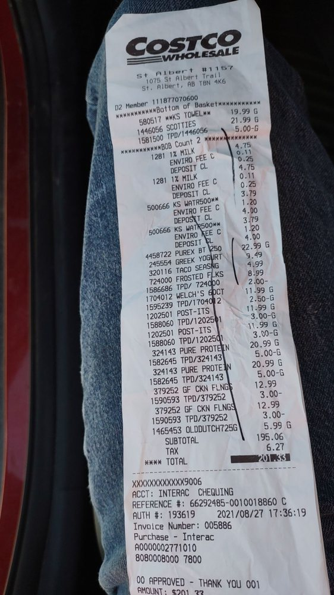
receiptcostco2.jpg
"[\"COSTCO\", \"WHOLESALE\", \"St Albert #1157\", \"1075 St Albert Trail\", \"St. Albert, AB TBN 4K6\", \"D2 Member 111877070600\", \"************Bottom of Basket***********\", \"580517 **KS TOWEL**\", \"19.99 G\", \"1446056 SCOTTIES\", \"21.99 G\", \"1581500 TPD/1446056\", \"5.00-G\", \"***********BOB Count 2 **************\", \"1281 1% MILK\", \"4.75\", \"ENVIRO FEE C\", \"0.11\", \"0.25\", \"DEPOSIT CL\", \"4.75\", \"1281 1% MILK\", \"ENVIRO FEE C\", \"0.11\", \"0.25\", \"DEPOSIT CL\", \"3.79\", \"500666 KS WATR500**\", \"ENVIRO FEE C\", \"1.20\", \"DEPOSIT CL\", \"4.00\", \"500666 KS WATR500**\", \"3.79\", \"ENVIRO FEE C\", \"1.20\", \"DEPOSIT CL\", \"4.00\", \"4458722 PUREX BT 250\", \"22.99 G\", \"245554 GREEK YOGURT\", \"9.49\", \"320116 TACO SEASNG\", \"4.99\", \"724000 FROSTED FLKS\", \"8.99\", \"1586686 TPD/ 724000\", \"2.00-\", \"1704012 WELCH'S 60CT\", \"11.99 G\", \"1595239 TPD/1704012\", \"2.50-G\", \"1202501 POST-ITS\", \"11.99 G\", \"1588060 TPD/1202501\", \"3.00-G\", \"1202501 POST-ITS\", \"11.99\", \"1588060 TPD/1202501\", \"3.00-G\", \"324143 PURE PROTEIN\", \"20.99 G\", \"1582645 TPD/324143\", \"5.00-G\", \"324143 PURE PROTEIN\", \"20.99 G\", \"1582645 TPD/324143\", \"5.00-G\", \"379252 GF CKN FLNGS\", \"12.99\", \"1590593 TPD/379252\", \"3.00-\", \"379252 GF CKN FLNGS\", \"12.99\", \"1590593 TPD/379252\", \"3.00-\", \"1465453 OLDDUTCH725G\", \"5.99 G\", \"SUBTOTAL\", \"195.06\", \"TAX\", \"6.27\", \"**** TOTAL\", \"201.33\", \"XXXXXXXXXXXX9006\", \"ACCT: INTERAC CHEQUING\", \"REFERENCE #: 66292485-0010018860 C\", \"AUTH #: 193619 2021/08/27 17:36:19\", \"Invoice Number: 005886\", \"Purchase - Interac\", \"A0000002771010\", \"8080008000 7800\", \"00 APPROVED - THANK YOU 001\", \"AMOUNT: $201.33\"]"

Slide 6
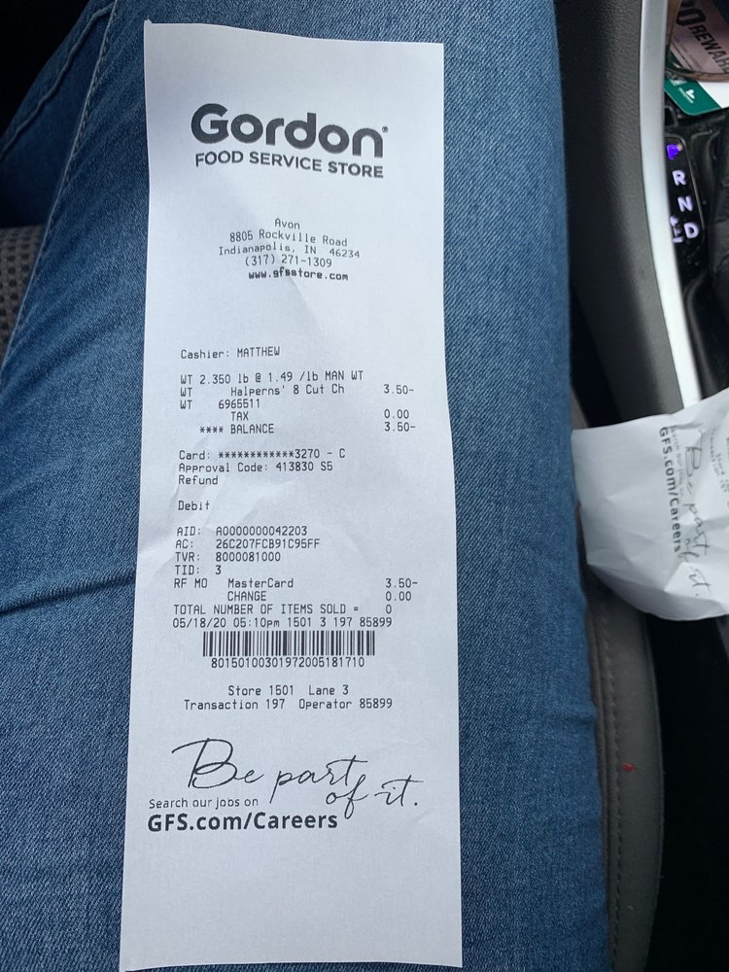
receiptgfs2
"[\"Gordon\", \"FOOD SERVICE STORE\", \"Avon\", \"8805 Rockville Road\", \"Indianapolis IN 46234\", \"(317) 271-1309\", \"www.gfsstore.com\", \"Cashier: MATTHEW\", \"WT 2.350 1b @ 1.49 /lb MAN WT\", \"WT\", \"Halperns' 8 Cut Ch\", \"3.50-\", \"WT\", \"6965511\", \"TAX\", \"0.00\", \"****\", \"BALANCE\", \"3.50-\", \"EFS\", \"Card: ************3270 - C\", \"5\", \"Approval Code: 413830 S5\", \"Refund\", \"Debit\", \"AID A0000000042203\", \"AC: 26C207FCB91C95FF\", \"TVR: 8000081000\", \"TID: 3\", \"RF MO\", \"MasterCard\", \"3.50-\", \"CHANGE\", \"0.00\", \"TOTAL NUMBER OF ITEMS SOLD .\", \"0\", \"05/18/20 05 :10pm 1501 3 197 85899\", \"80150100301972005181710\", \"Store 1501 Lane 3\", \"Transaction 197 Operator 85899\", \"Be\", \"part\", \"Search our jobs on\", \"of\", \"it.\", \"GFS.com/Careers\"]"

Slide 7
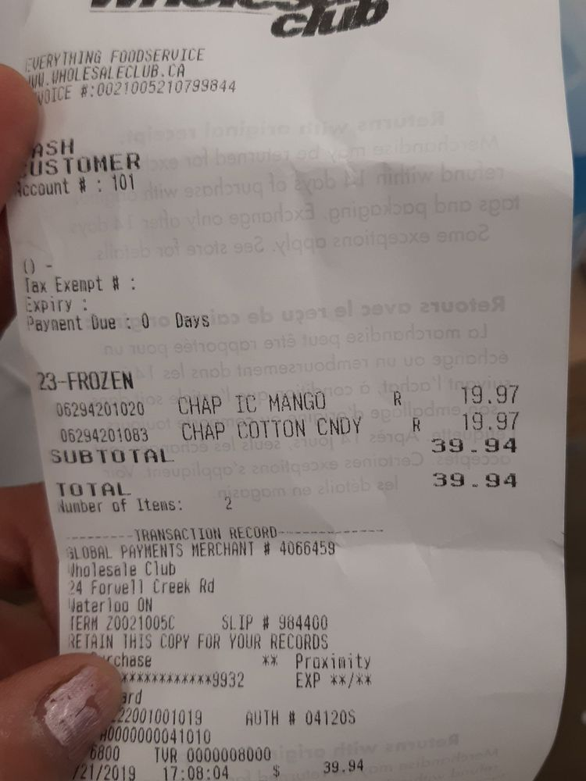
receiptwc1.jpg
"[\"club\", \"EVERYTHING FOODSERVICE\", \"IIII. UHOLESALECLUB.CA\", \"VOICE #:0021005210799844\", \"ASH\", \"USTOMER\", \"Account # : 101\", \"() -\", \"Tax Exempt # :\", \"Expiry :\", \"Payment Due :\", \"0\", \"Days\", \"nu\", \"23-FROZEN\", \"06294201020\", \"CHAP IC MANGO\", \"R\", \"19.97\", \"06294201083\", \"CHAP COTTON CNDY\", \"R\", \"19.97\", \"SUBTOTAL\", \"39.94\", \"TOTAL\", \"39.94\", \"Number of Items:\", \"2\", \"TRANSACTION RECORD\", \"GLOBAL PAYMENTS MERCHANT # 4066459\", \"Wholesale Club\", \"24 Forwell Creek Rd\", \"Waterloo ON\", \"TERM Z00210050\", \"SLIP # 984400\", \"RETAIN THIS COPY FOR YOUR RECORDS\", \"chase\", \"** Proximity\", \"************9932\", \"EXP **/**\", \"ard\", \"22001001019\", \"AUTH # 04120S\", \"A0000000041010\", \"6800\", \"TVR 0000008000\", \"/21/2019 17:08:04 $ 39.94\"]"

Slide 8
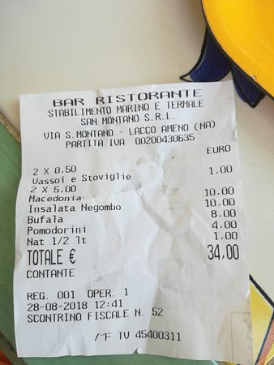
1197-receipt.jpg
"[\"BAR RISTORANTE\", \"STABILIMENTO MARINO E TERMALE\", \"SAN MONTANO S.R.L.\", \"VIA S. MONTANO - LACCO AMENO (NA)\", \"PARTITA IVA 00200430635\", \"EURO\", \"2 X 0.50\", \"Vassoi e Stoviglie\", \"1.00\", \"2 X 5.00\", \"Macedonia\", \"10.00\", \"Insalata Negombo\", \"10.00\", \"Bufala\", \"8.00\", \"Pomodorini\", \"4.00\", \"Nat 1/2 1t\", \"1.00\", \"TOTALE \\u20ac\", \"34,00\", \"CONTANTE\", \"REG. 001 OPER. 1\", \"28-08-2018 12:41\", \"SCONTRINO FISCALE N. 52\", \"MF TV 45400311\"]"

